Slide 1
Warm Up:
Welcome to class. Collect your INB, pencil, calculator.
What is the average temperature in degrees celsius of the following measurements? (this is the metric unit, you may be more familiar with fahrenheit). Open to next page in your INB to calculate the following:
16, 17, 14, 13
Average (mean) =
If the temperature (surface temperature) is 15.5 degrees celsius, would the temperature be warmer or colder than average? By how much?

Slide 2
Climate Change: Lesson 3
Global Temperature Patterns

Slide 3
Climate Change:
EQ: What factors are causing changes in salmon population?
Create a title page in your INB.
Write title: Climate Change Impacts.
Beneath your title, write this Essential Question.

Slide 4
In the Lesson you will:
Take notes and analyze data to explain the idea of a temperature anomaly.
Analyze data to describe changes of global temperature change over time.
At the end of the lesson you will be able to:
Describe the pattern of surface temperature change around the globe over time.
Show your proficiency at analyzing and interpreting data.

Slide 5
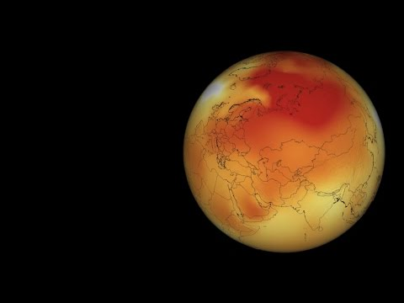
How do we measure global surface temperature?
What did you hear?
Work with your table group to write down the three ways we measure global surface temperature.
Use the white board to record.
Notes:
https://www.youtube.com/watch?v=3Uv26dIgaKs&t=2s

Slide 6
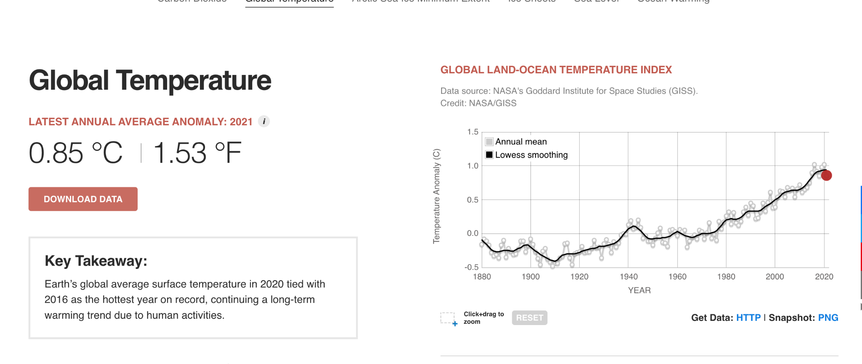
How do we analyze global surface temperature? Identify the x and y axis variables. What are we measuring? Write your response on the white board with your table group.

Slide 7
What is a Temperature Anomaly:
Write this definition in your INB: :
A temperature anomaly is the degree in celsius of how much warmer (or colder) the surface temperature is than what would normally be typical for that region. It is the difference in temperature from the average.

Slide 8
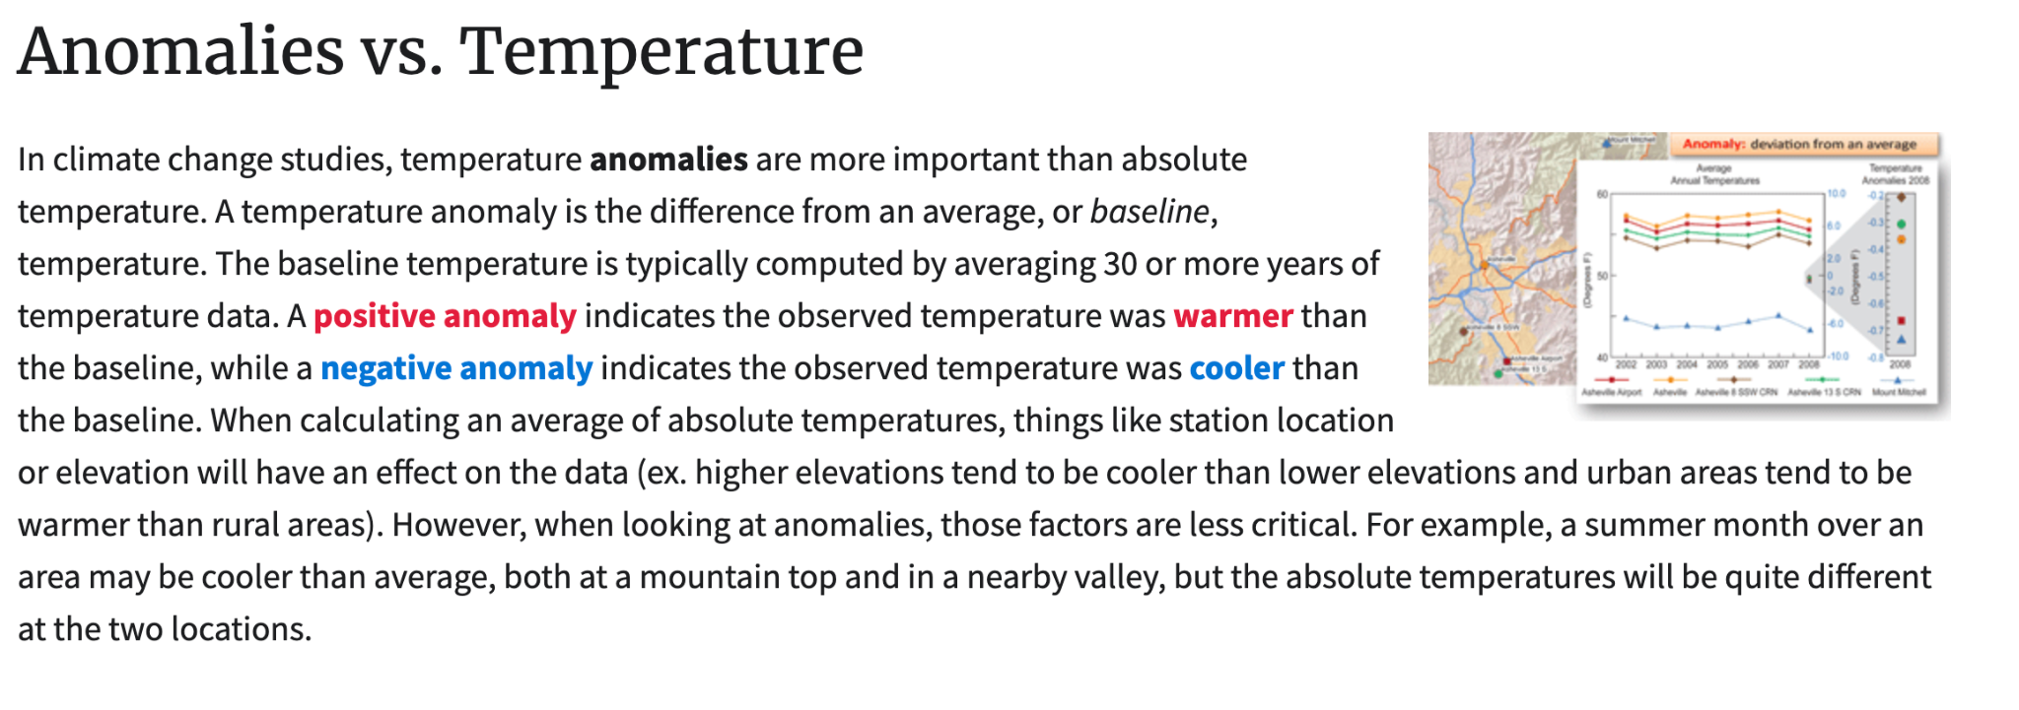
Collect a print out of the passage above and glue/tape into your INB. Read and respond to the following questions in your INB. Include the question in your response:
What is a temperature anomaly?
How is the baseline or average temperature computed?
What does it mean if the data shows a positive anomaly?
What does it mean if the data shows a negative anomaly?

Slide 9
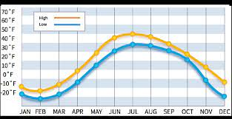
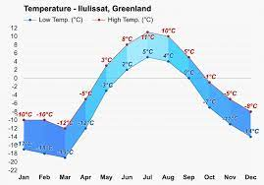
Warm Up:
Welcome to class. Find your assigned seat. Collect your INB, pencil, red and blue pencils, calculator.
The absolute temperature in the Arctic in degrees Fahrenheit and degrees celsius. What pattern do you notice?
Thank you for keeping voices off and staying seated unless directed.

Slide 10
What is a Temperature Anomaly:
The baseline is the temperature over a 30-year average. For example:
In Oregon City the max surface temperature is recorded every day between 1960-1990. Here is the data recorded for Dec 1st over these 30 years in celsius (℃). Use the data below to find the baseline temperature (average )for Dec 1st.
What is the baseline (also called the average) temperature for Dec 1st at Oregon City over this time period?
On Dec 1st, 2023 the temperature was recorded as 10℃ How much different is this from the baseline?
We call the difference from the baseline an anomaly.
Is this a negative or a positive anomaly? Why do you say this?
12/1/1960: 3℃ | 12/1/1961: 8℃ | 12/1/1962: 9℃ | 12/1/1963: 13℃ | 12/1/1964: 8℃
12/1/1965: 15℃ | 12/1/1966: 12℃ | 12/1/1967: 8℃ | 12/1/1968: 6℃ | 12/1/1969: 10℃
12/1/1970: 12℃ | 12/1/1971: 6℃ | 12/1/1972: 12℃ | 12/1/1973: 8℃ | 12/1/1974: 9℃
12/1/1975: 7℃ | 12/1/1976: 6℃ | 12/1/1977: 10℃ | 12/1/1978: 11℃ | 12/1/1979: 6℃
12/1/1980: 8℃ | 12/1/1981: 12℃ | 12/1/1982: 10℃ | 12/1/1983: 8℃ | 12/1/1984: 7℃
12/1/1985: 5℃ | 12/1/1986: 3℃ | 12/1/1987: 7℃ | 12/1/1988: 10℃ | 12/1/1989: 12℃

Slide 11
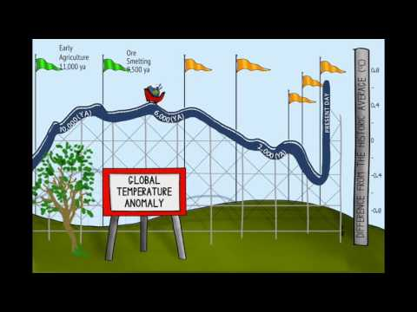
Review: Global Temperature Anomaly (this means difference). How much different is the global temperature from the average temperature in the past….

Slide 12
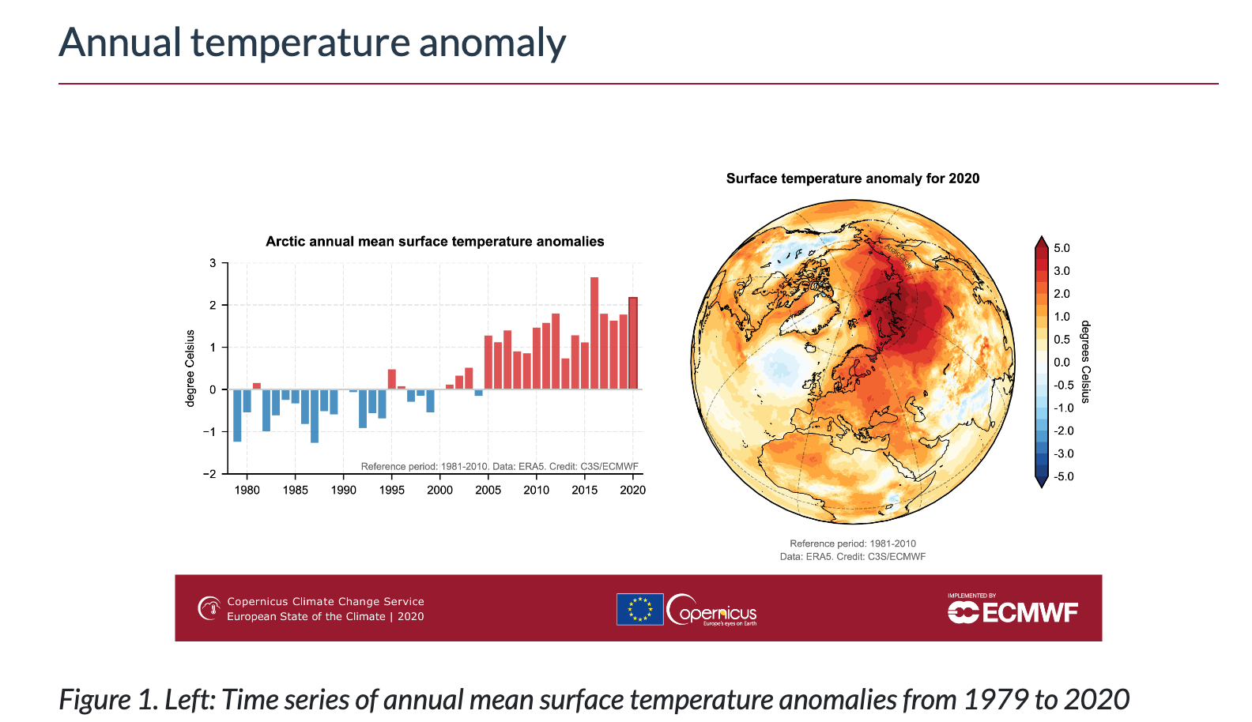
Welcome to class. Find your assigned seat. Collect your INB, pencil.
Work in groups to examine this data:
On the whiteboard respond to the following questions.
What is the x-axis variable?
What is the y-axis variable?
How much warmer is the Arctic now (latest data) than the average?
In 1980 was the Arctic hotter or colder than average? How can you tell? By how much?
What about in 1990?
What years is there no difference from the average temperature? Why do you say this.

Slide 13
Review:
What does the zero line represent (show)?
Why do some bars go up and some down?
What do the red and blue colors mean?
Where can I find the definition of what a temperature anomaly?

Slide 14
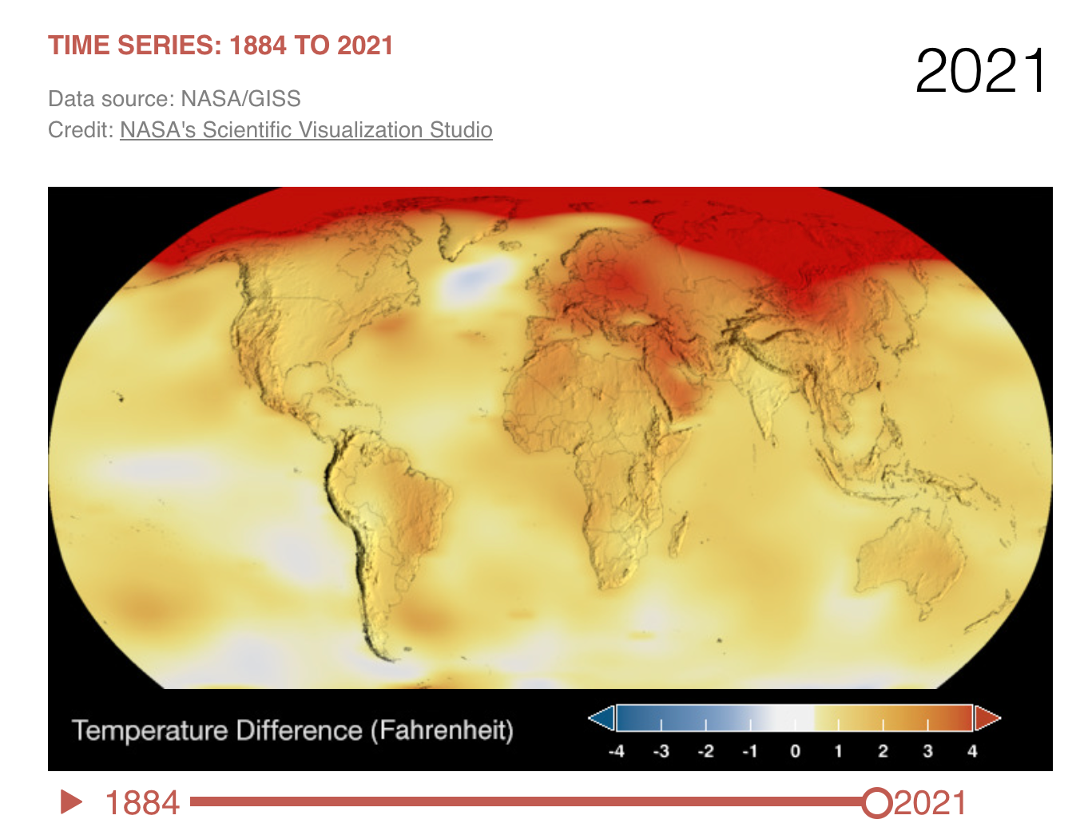
Exit ticket:
In his analysis of the data shown below, Jason wrote that the Arctic is the warmest place on Earth. The teacher said he was wrong. Why did she say that?

Slide 15
Warm Up:
Welcome to class. Find your assigned seat. Collect your INB, pencil
In 2023, the Arctic recorded an increase in average temperature of 2.5℃. This means: (select all that apply)
The temperature at the Arctic was 2.5℃
The average temperature is 2.5℃
The arctic experienced a hotter environment than normal.
The temperature anomaly in the Arctic was 2.5 ℃
Normally the temperature is 2.5℃ cooler
The baseline temperature is 2.5℃
We don’t know the average temperature, just the difference from the average.
Thank you for keeping voices off and staying seated unless directed.

Slide 16
Review:
What does the zero line represent (show)?
Why do some bars go up and some down?
What do the red and blue colors mean?
Where can I find the definition of what a temperature anomaly?

Slide 17
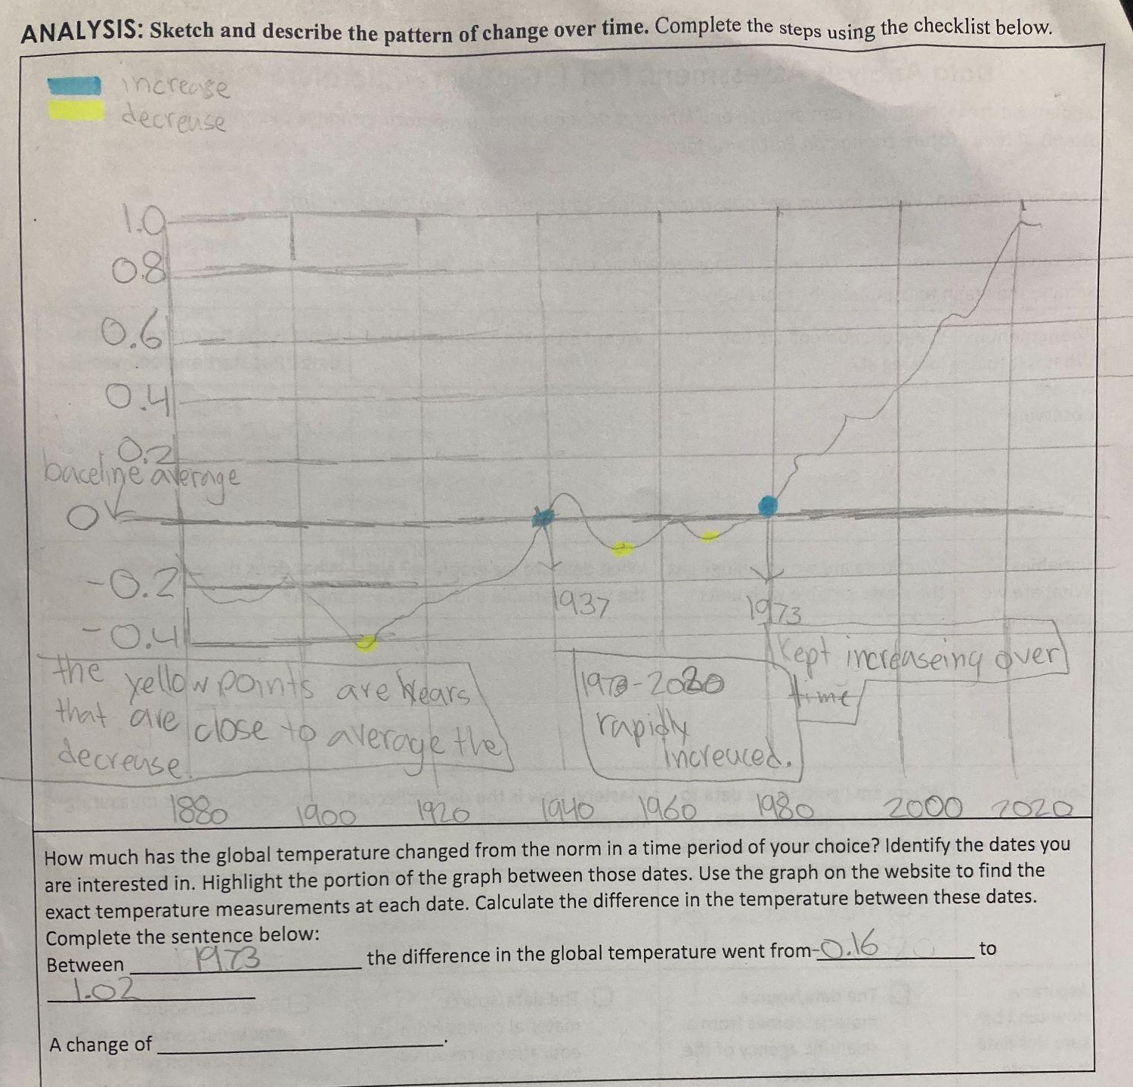
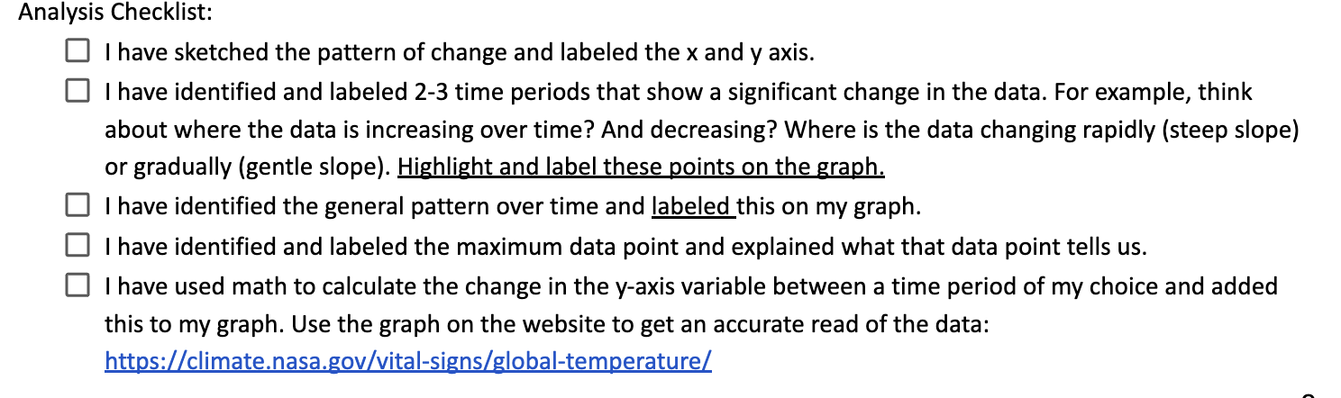
Warm Up:
Welcome to class. Find your assigned seat. Collect your INB, pencil, salmon file and your assessment.
Grade this work in progress:
Thank you for keeping voices off and staying seated unless directed.

Slide 18
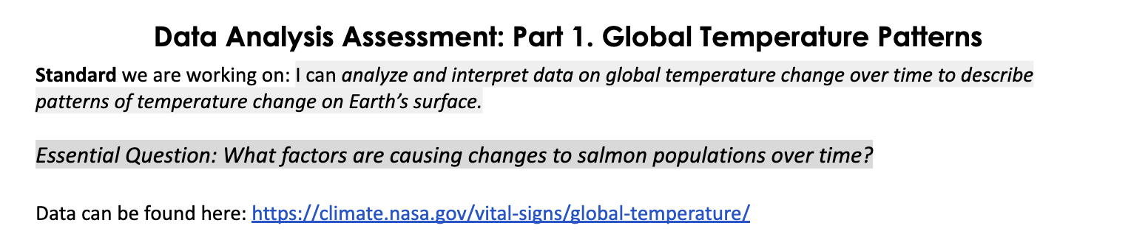
Assessment: Data Analysis and Interpretation
This is your own individual work.
Please work in silence and allow others to complete their work.
Stay at your seat.
Remember to add your name, period and date. USE A PENCIL AND BE NEAT.

Slide 19
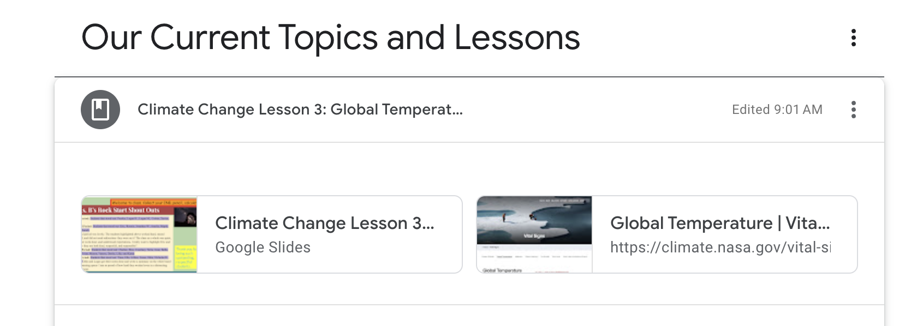
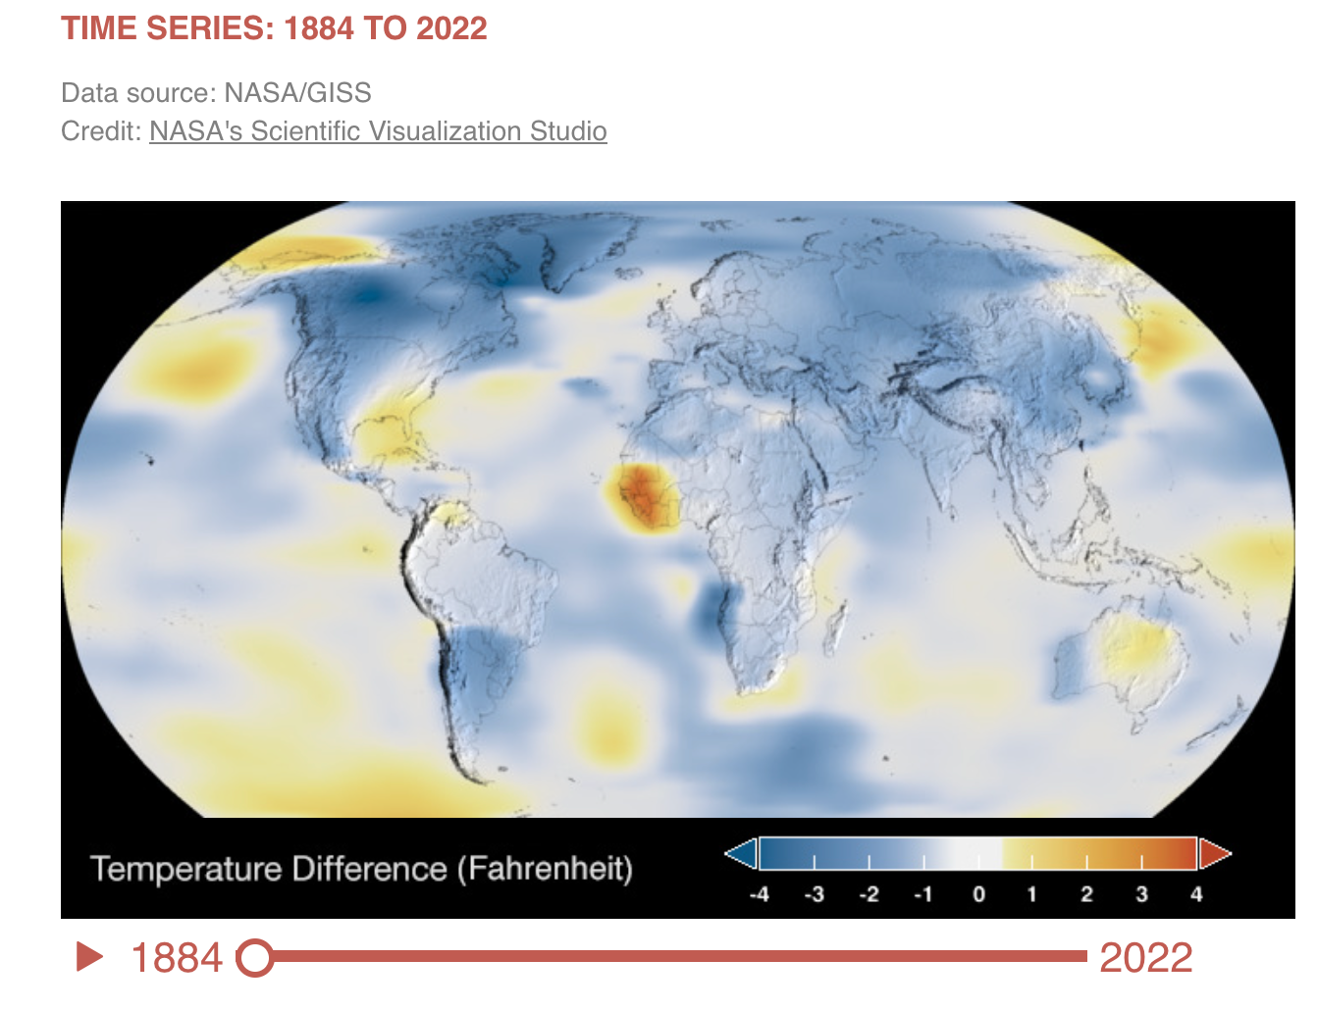
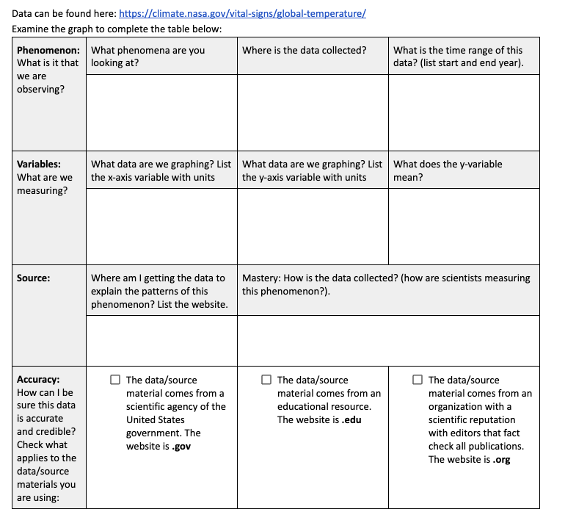
Assessment: Data Analysis and Interpretation
Step 1: Go GC> Lesson 3 and find the NASA website Global Temperature Change.
Step 2: Read the webpage and examine the data. You will find one graph, the data is shown as a line and a time lapse model of the globe showing surface temperature patterns over time.
Step 3: Complete Phenomena, Variables, Source, and Accuracy parts of the table. Check in with me for a stamp before moving on. I am here to help you.
Step 4: Complete the Analysis. Describe the patterns of change of global surface temperature over time. Use the Checklist to make sure you are meeting the PROFICIENCY requirements for this assessment.
Mastery: Watch and record in your Source column how scientists collect this data here: https://www.youtube.com/watch?v=3Uv26dIgaKs&t=2s

Slide 20
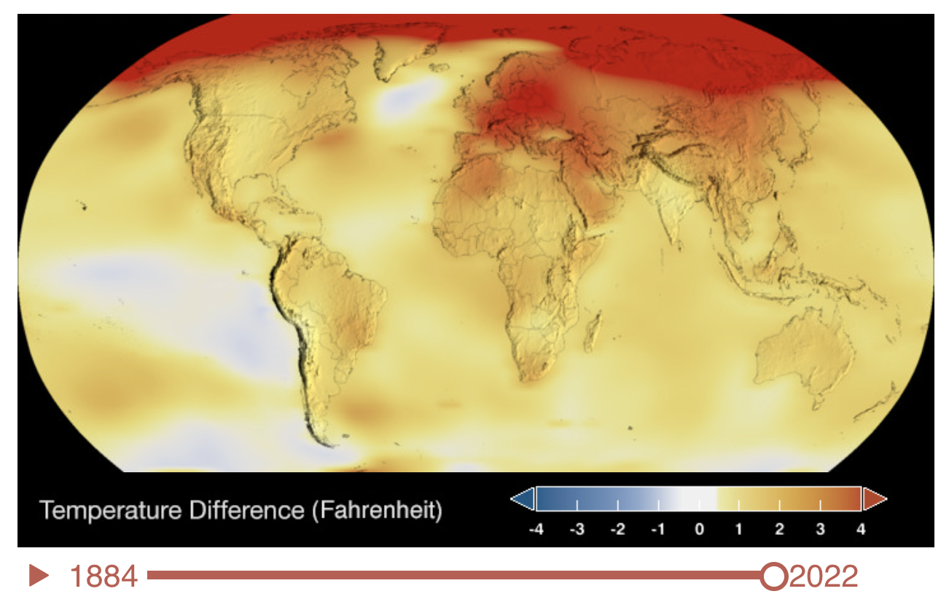
Exit ticket:
Uncle Al says to you “How can the Earth be warming when it is cold outside today? How would you respond?
Record the question and your response in your INB.
Check with me for a stamp.

Slide 21
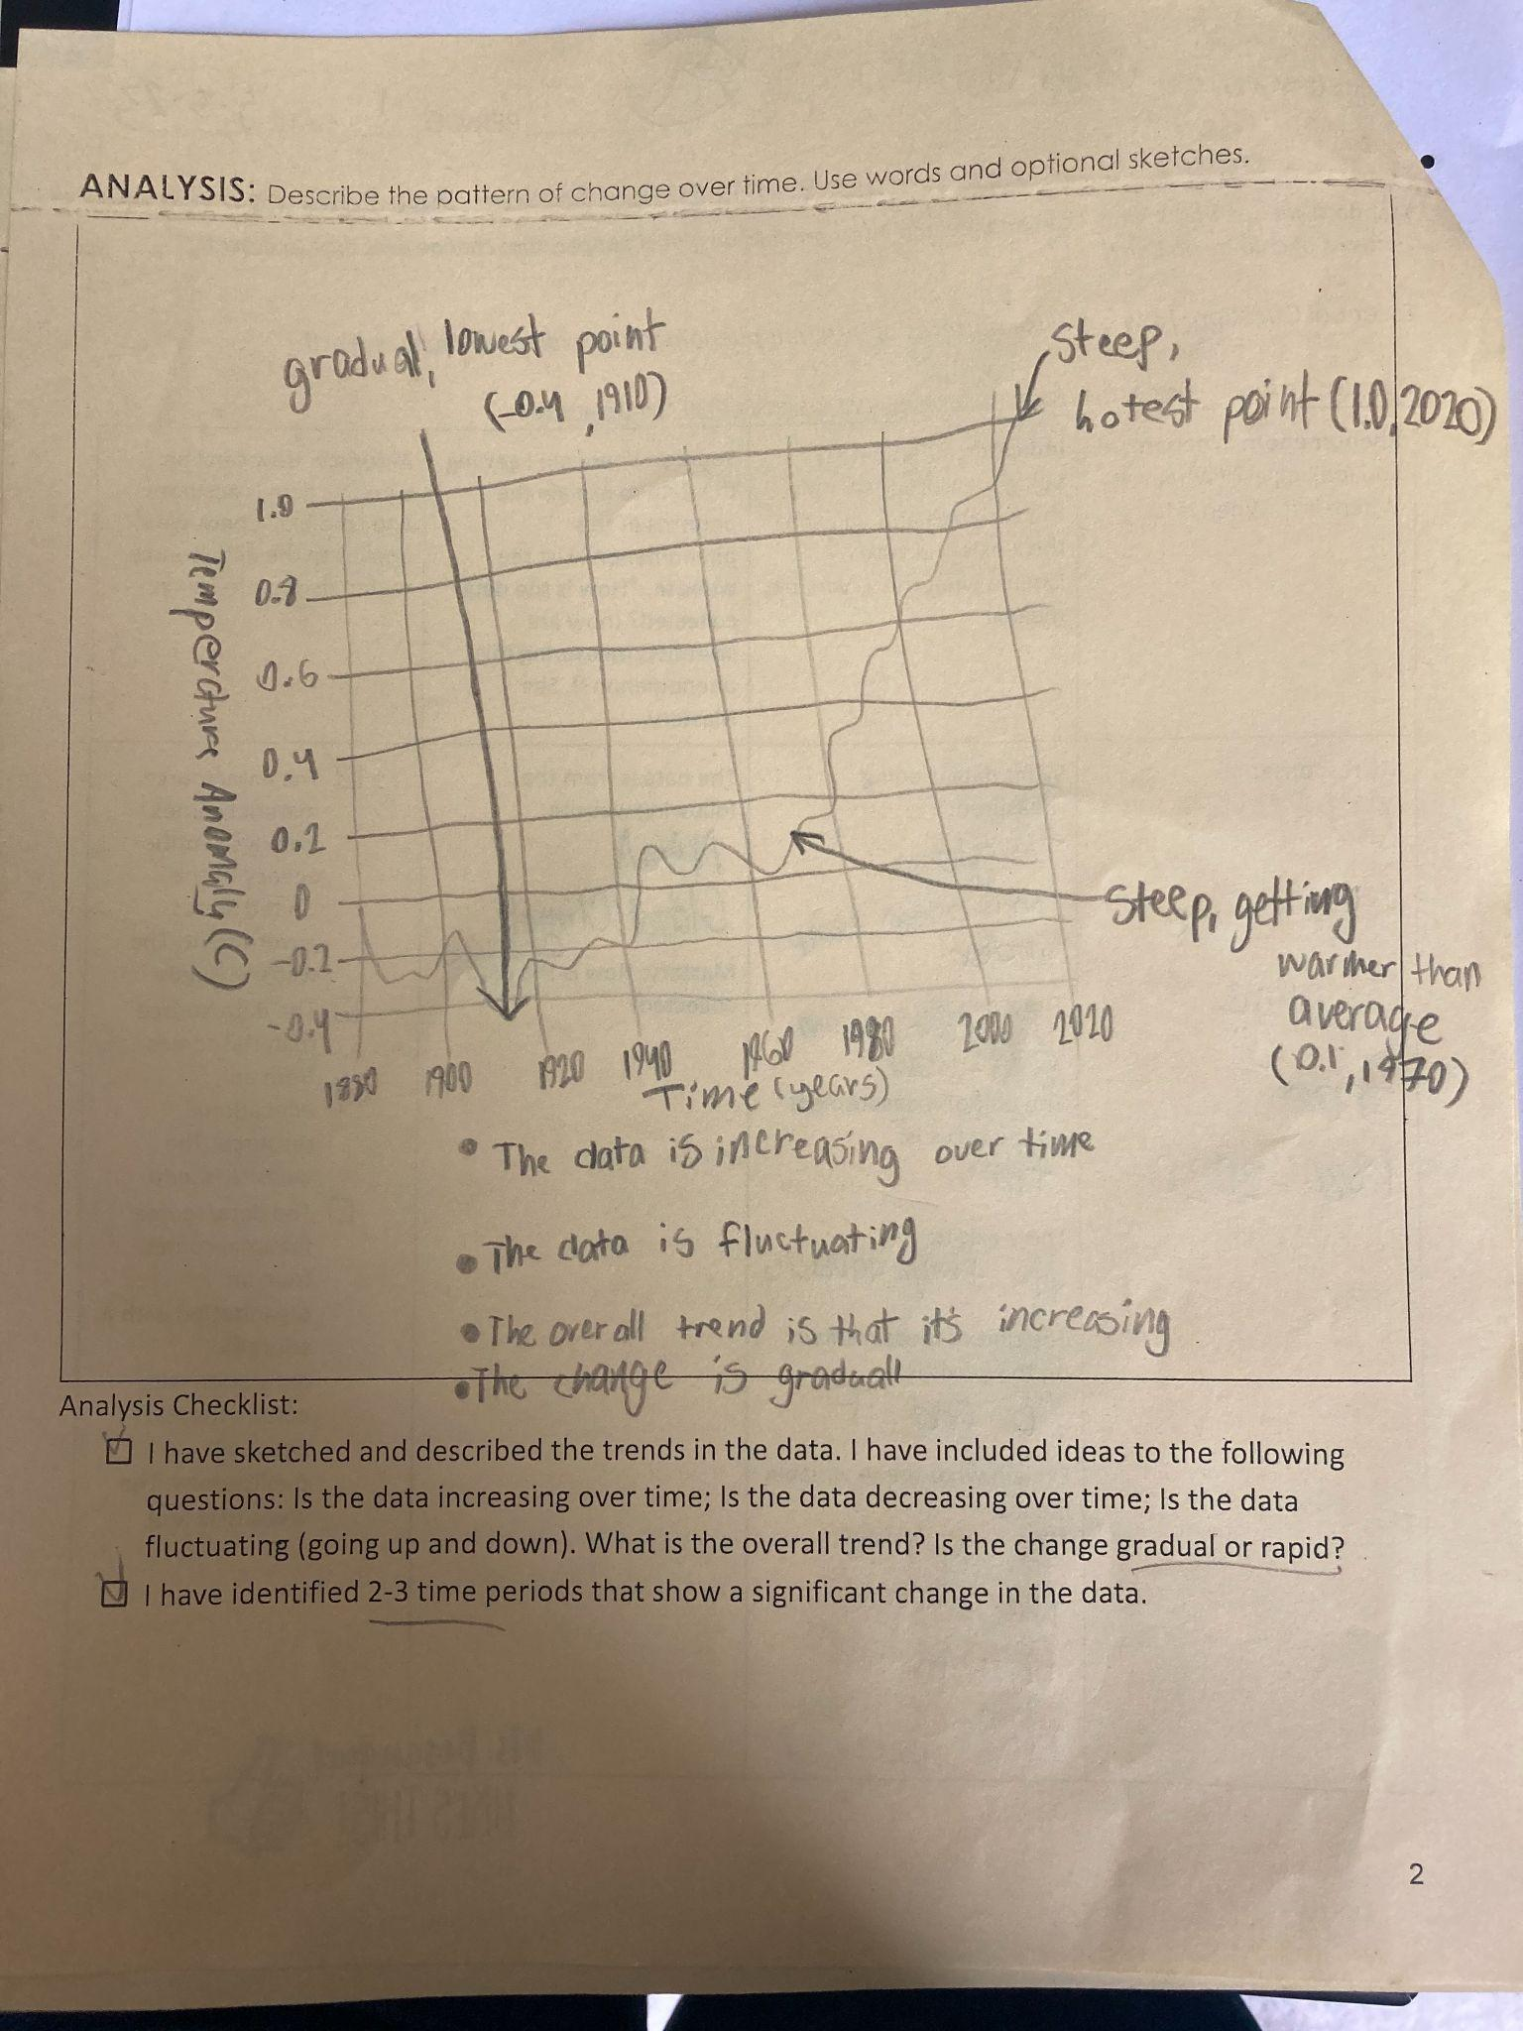
Example of analysis work. What is missing?

Slide 22
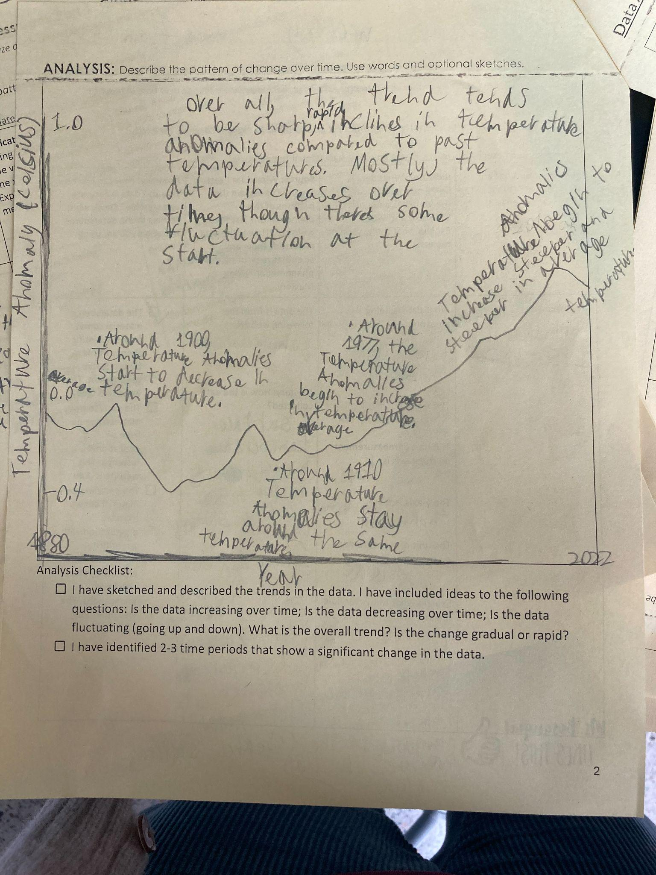
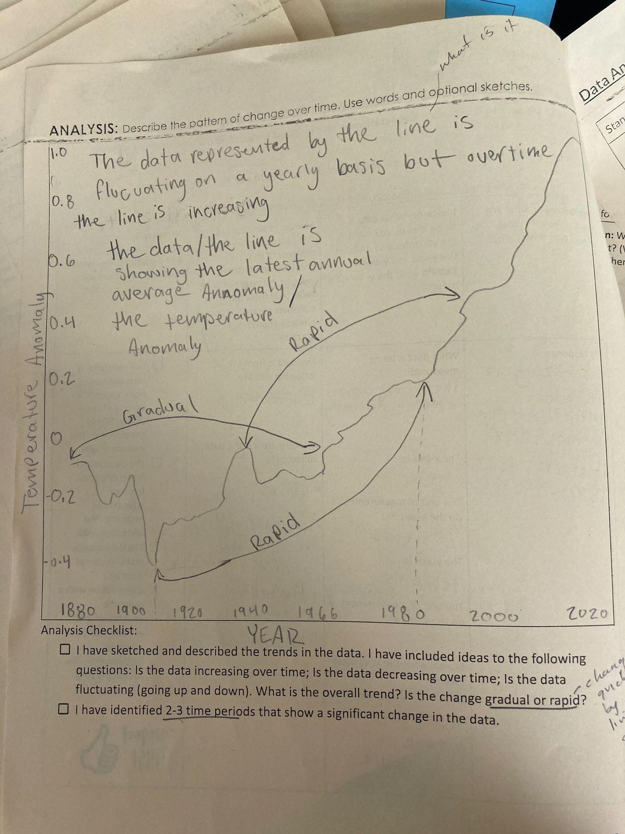
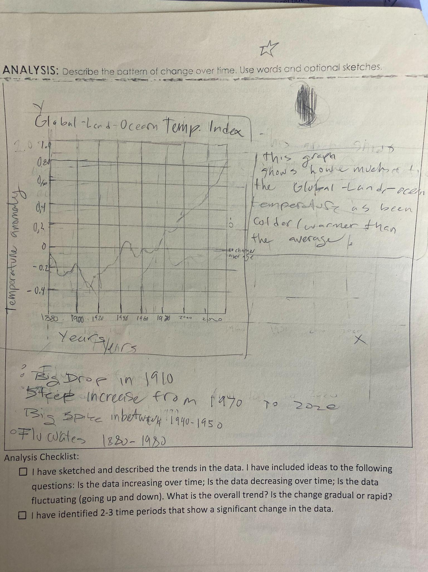
Analysis

Slide 23
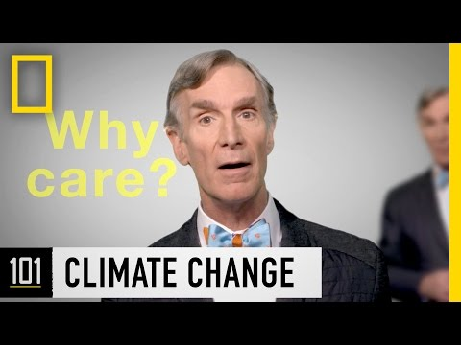
Wrap Up:

Slide 24
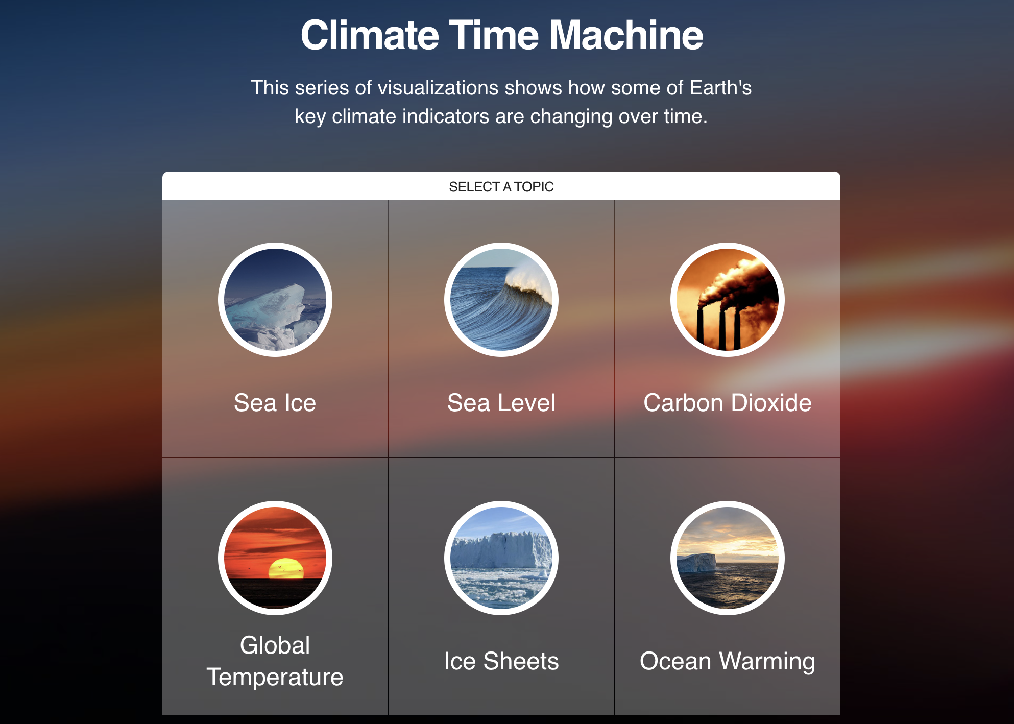
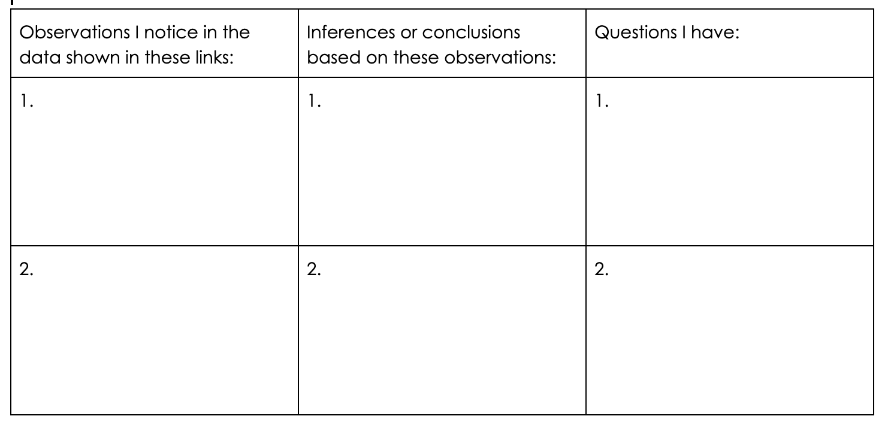
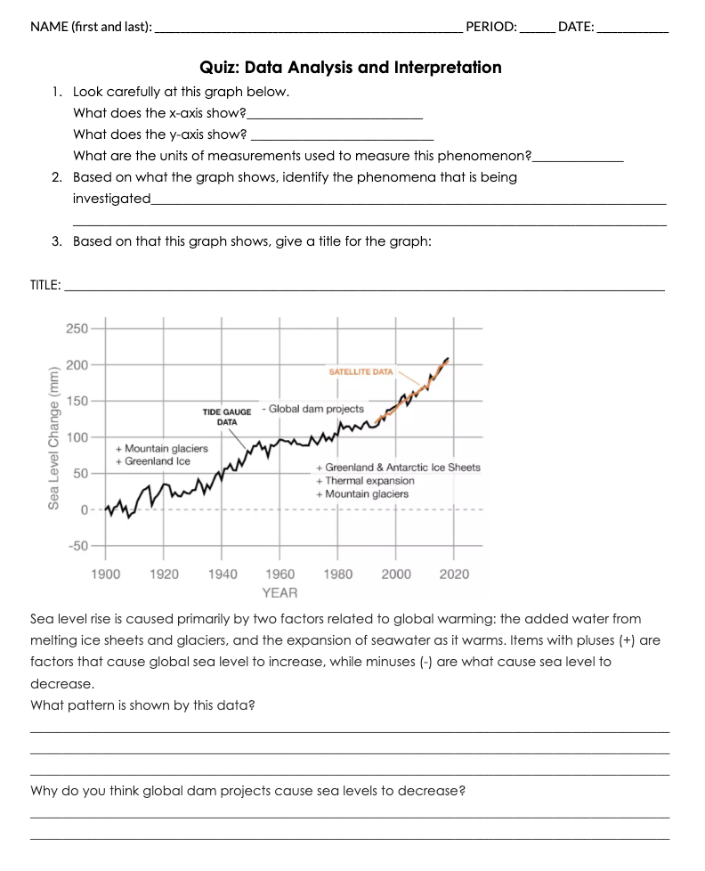
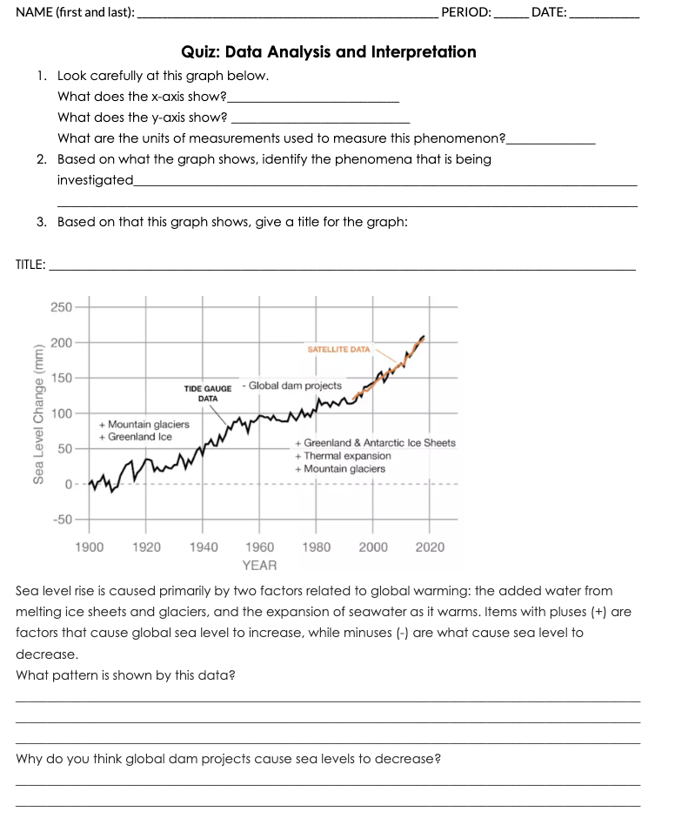
Extension:
Click on the Climate Time Machine image to take you to the NASA webpage.
Explore this data and the images here:
https://climate.nasa.gov/images-of-change/?id=809#809-dusty-ice-on-icelands-largest-glacier
Create the following table in your INB. Use they information you explore in the Climate Time Machine link to complete the table.
Complete quiz handout.

